Slide 1
A comparative study on different Models for Community Detection
Olusanmi A. Hundogan
Notes:
I dubbed my paper XXXX and it explains veryx straight forward what I attempted to do in my paper. The model is an interesting aspect of any community detection part and is definitely something someone would have to think about when designing an algorithm.
For this paper’s purpose we will understand the model as underlying principle which governs how a partition is chosen to be the best. It corresponds with quality functions which quantify the fitness of a partition.

Slide 2
Research Question
What is the influence of the model on the NMI performance of the community detection task?
Which model yields the best performance?
Notes:
I focused on two very clear research question

Slide 3
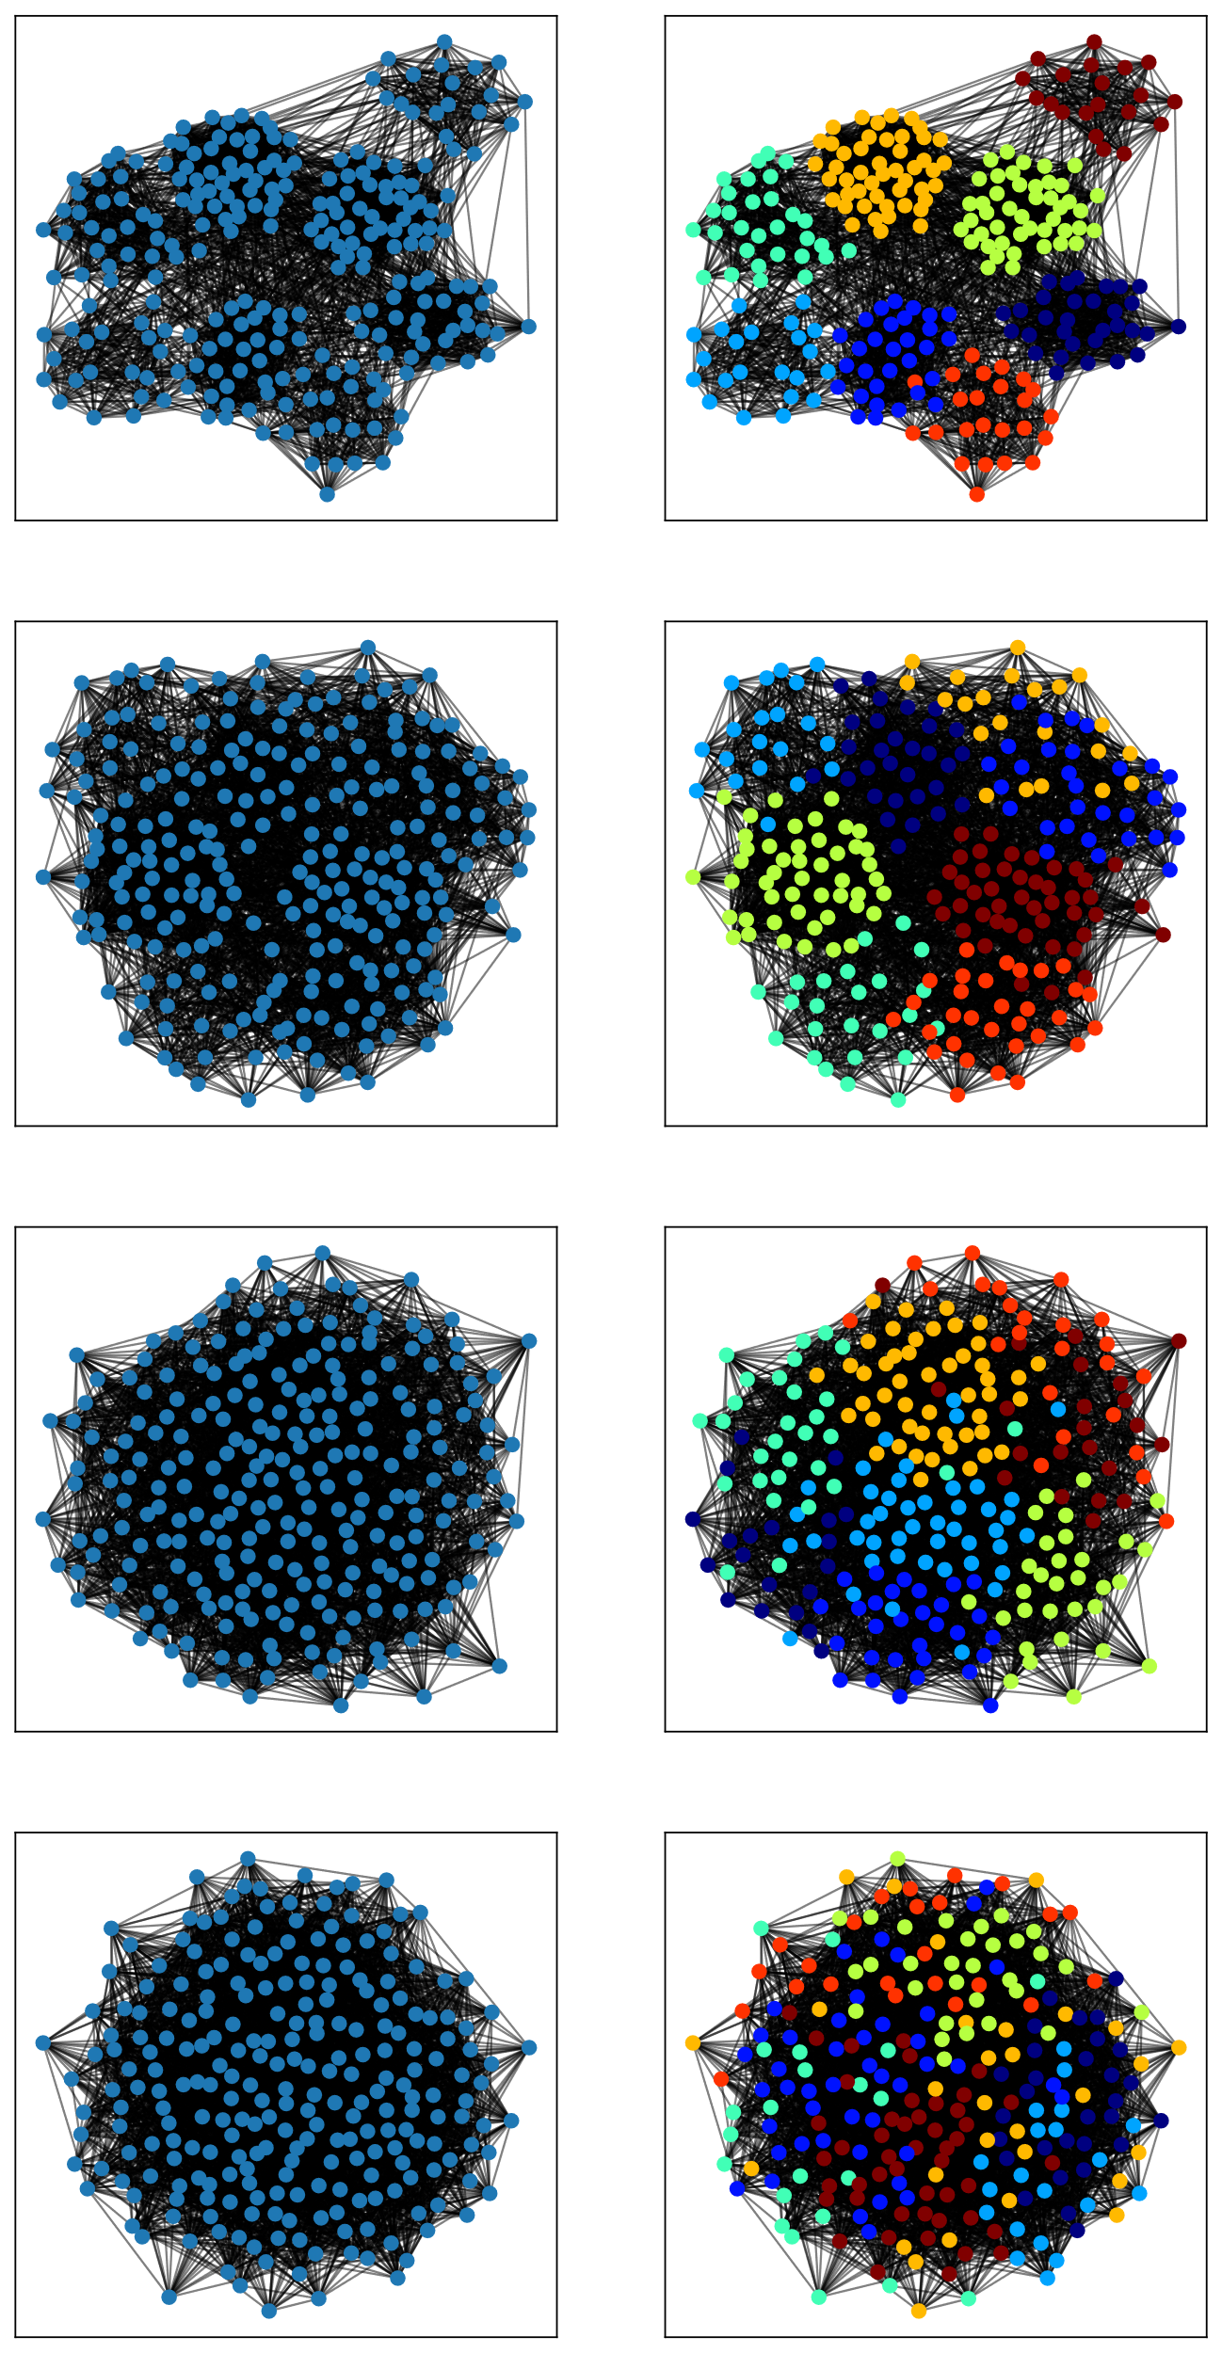
Experimental Setup
Mixing parameter µ increases
LFR Benchmark
Graph Sizes: 250, 500
Node degree power exponent: 2.0
Community power exponent: 1.1
Minimum Degree: 20
Maximum Degree: 50
NMI Score
Increase µ overtime: 0.1 – 0.7
Partitioning Algorithm: Louvain Core
Notes:
The general experimental setting is quite simple. I am using the LFR Benchmark. The slide lists some of the parameters. I vaired the mixing parameter until 0.7 because the theoretical limit of detectability was 0.75.
I am going to fix the partitioning algorithm or heuristic but inspect the results of different models, which I have implemented myself. So the models are a bit more interesting.

Slide 4
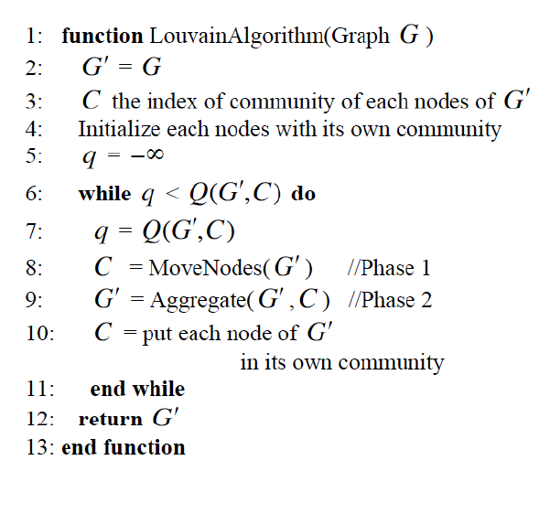
Louvain-Core
Louvain core is the Louvain algorithm without a predetermined quality function
Phase 1: Initialize every node with its own partition
Phase 2: For every node in a random sequence of nodes, check if the inclusion into an adjacent node’s partition maximizes the quality function. Repeat until no changes apply.
Phase 3: Aggregate the communities into super nodes and repeat Phase 2 until no further improvement can be reached.
(the Graduate School of Information Science and Technology, University of Tokyo, Tokyo, Japan. et al. 2016)
Notes:
However, we gotta talk about Louvain-Core a bit. For that you kind of need to know that you can split the general Louvain algorithm into the core heuristic to find the partition and the quality used to evaluate it. I fixed the core heuristic that I’ve implemented myself and tried to switch the quality function without changing the core.
The core itself consists of three phases. First, initializing all the nodesin their own partition. Then for each node assigning a partition according to the quality function, until no improvements apply anymore. Last, aggregate the current communities and repeat these steps for the reduced networks.

Slide 5
Models
Modularity
MapEquation
Similarity

Slide 6
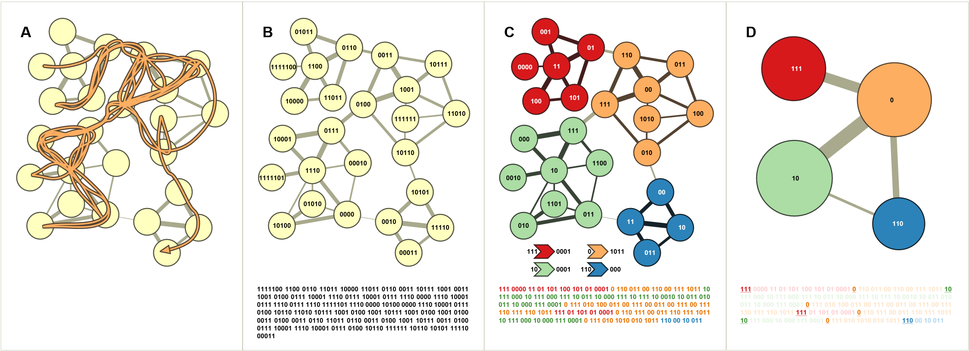
Models – MapEquation
MapEquation
Notes:
Now. I am going to explain the MapEquation as it is slightly more complicated. The idea is rooted in information theory and it leverages the flow dynamics of the graph.
Let’s assume you want to keep track of a random walk on a sheet of paper. You’d encode every node with a specific codename and take note of them. But what if node fourhoundredtwentyonethousandthreehundredandthirtyseven is very frequently visited.
Your sheet of paper will have a very large average codelength and this is inefficient.
Let’s rather give frequent nodes short names and infrequent nodes longer names.
We can be even more efficient if we specify regions and restart the coding schemes. This is where partitions come into play.
You see, the right partition corresponds with the most efficient codeing scheme.
And because the average code length corresponds with entropy, all we need are the frequencies of nodes and the community transitions.
This comes together in the MapEquation below.
It consists of the community transition entropies and the individual community entropies but wieghted by the time the random walker spends in them..

Slide 7
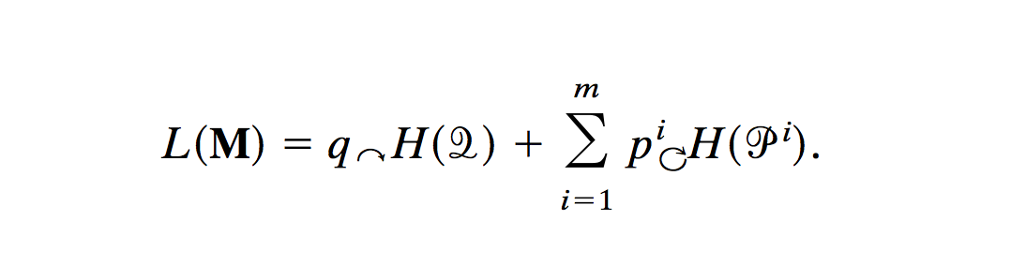
Models – MapEquation
MapEquation
(Rosvall, Axelsson, and Bergstrom 2009)
Notes:
Now. I am going to explain the MapEquation as it is slightly more complicated. The idea is rooted in information theory and it leverages the flow dynamics of the graph.
Imagine trying to efficiently keep track of a random walker on a sheet of paper. The best idea would be to give each node a codename and write it down.
This is especially cumbersome if we pick a long codename for a node which happens to be passed a lot. It kinda leads to an inefficient use of the paper because the average codelength of the walk would be quite high. And we could have done better by picking short codenames for frequent nodes. Hence, lets take the probabilities of the nodes and use them to decide which node gets which codename. This is what Huffman-encoding does with binary values.
The same idea applies to partitions if we pick nodes in our partition which do not work well with the general flow of the partition, we cannot efficiently encode them. Meaning, the goal of finding the best partition is the goal of minimizing the average code length we get for a specific encoding of all the partitions. If we additionally keep track of partition transitions, we know the amount of codelength the partition contributes to the overall average codelength.
How do we translate average code length into math? By using entropy as it corresponds with the most efficient encoding that one can come up with, having the probabilities of the nodes.

Slide 8
Models
Modularity
MapEquation
Similarity

Slide 9
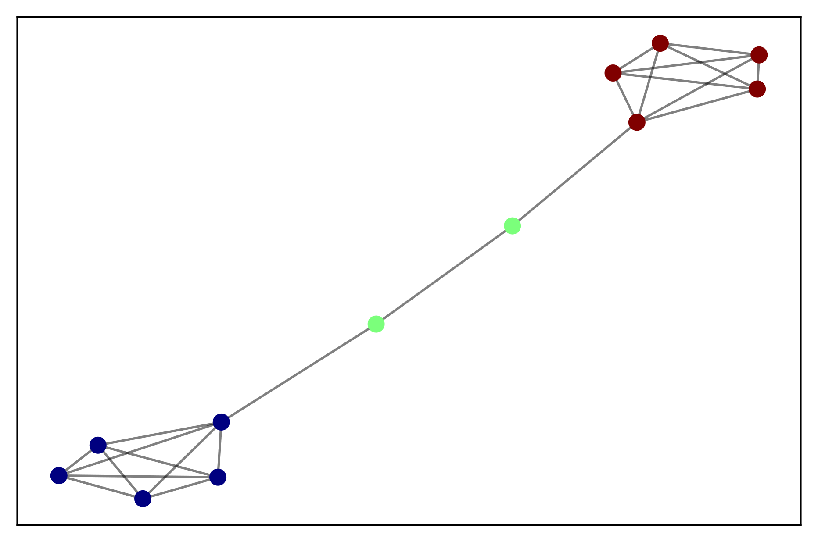
Models – Node-Similarity
Similarity
Notes:
This was MapEquation, now about node-similarity: Most of you will have a general intuition. Nodes in a community are likely similar. The same way as friends are in a social communities.
Hence the objective is to find a partition whose community centres are closest to all nodes in each respective community.
The trivial solution of that would be each individual node itself as partition. Which is the initial state. Hence, not very helpful.
So what I did instead was to define a movement-gain, which effectively just keeps track of the reductions in the average centroid difference in the giver community and in the receiver community.
So we optimize towards the most effective move considering both of the communities in question.
You can add the gains or multiply them. I decided on multiplying them.
This is very reminiscent of things ideas like k-means and therefore a bit less interesting.

Slide 10
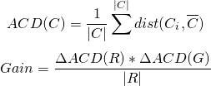
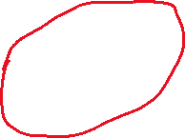
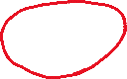
Models – Node-Similarity
Similarity
Notes:
Most of you will have a general intuition of the similarity idea. One can say that nodes in a community must be similar in a way. The same way as friends are in a social community. This can be leveraged for community detection in various way. In this paper I went for the interpretation that nodes will be closest to their true partition center which is latent. Hence the objective is to find a partition whose center is closest to all nodes in its partition. The trivial solution of that would be each individual node itself as partition. Which is the initial state. Hence, not very helpful.
However, I reformulated this idea by defining “Movement-Gain”. The idea was that a node must move towards the partition which reduces the average distance to the centroid the most. As this gain has too parts, the giving node, which will most likely reduce the average centroid distance of the giving node. The receiving node will most likely increase its average centroid distance. But sometimes it is also more beneficial to abandon a community or to erase it if this yields more gain.
By dividing the gain in two parts and terms of change rather than absolute values we can compute optimize towards some sort equilibrium. The only question only becomes how to represent the nodes.

Slide 11
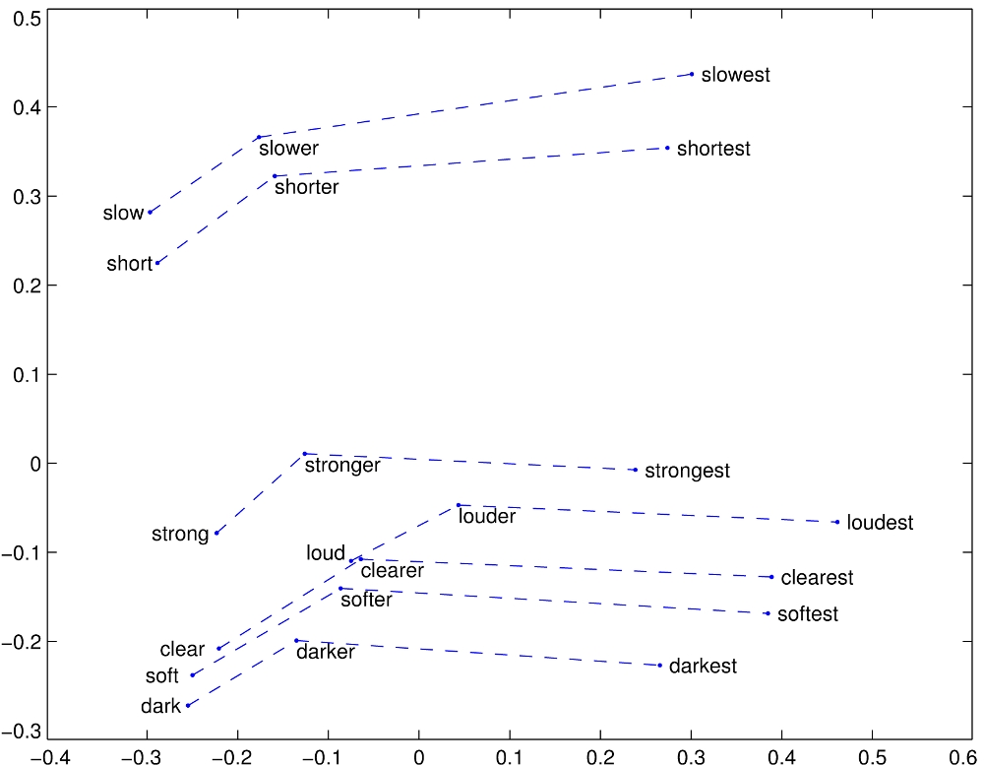
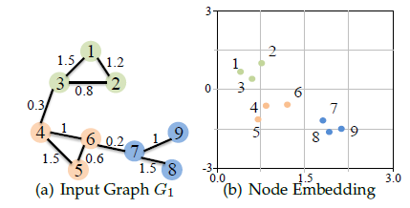
Models – Node-Similarity
Similarity
(Cai, Zheng, and Chang 2018)
https://nlp.stanford.edu/projects/glove/
Notes:
The only question only becomes how to represent the nodes. And this is way more interesting, because this is not a trivial question. Naïve representations like one hot encoding typically loose all the structural information of the node. What I did was to borrow from the natural language processing community.
There are various issues in representing nodes in such a way that their similarity or distance maintains their structural properties. In this paper I am using GloVe or Global Vectors which is a method to train word embeddings. Words are also very hard to represent without loosing a lot of their semantic content, but with GloVe the representation is learned. Those are low-dimensional vectors for each
There are other ways to learn representations, like word2vec, but Glove is very fast as most of the work is handled by initializing a long random walk and then count cooccurences of nodes within a given window. If you have those you can optimize for GloVe’s objective to approximate the cooccurrence matrix and use the trained parameters as node-embeddings.
The idea behind node embeddings based on their cooocurence is that they contain the structural information of the flow dynamics of a graph as you can see in the second image.

Slide 12
Models - Baselines
Random
Labelpropagation
Coverage
Notes:
Now that I talked a lot about the important models a short node on the baselines. Random is just as it says.
Labelpropagation does not use a quality function but the majority vote of the neighbors.
Coverage is like modularity but without substracting the null model.

Slide 13
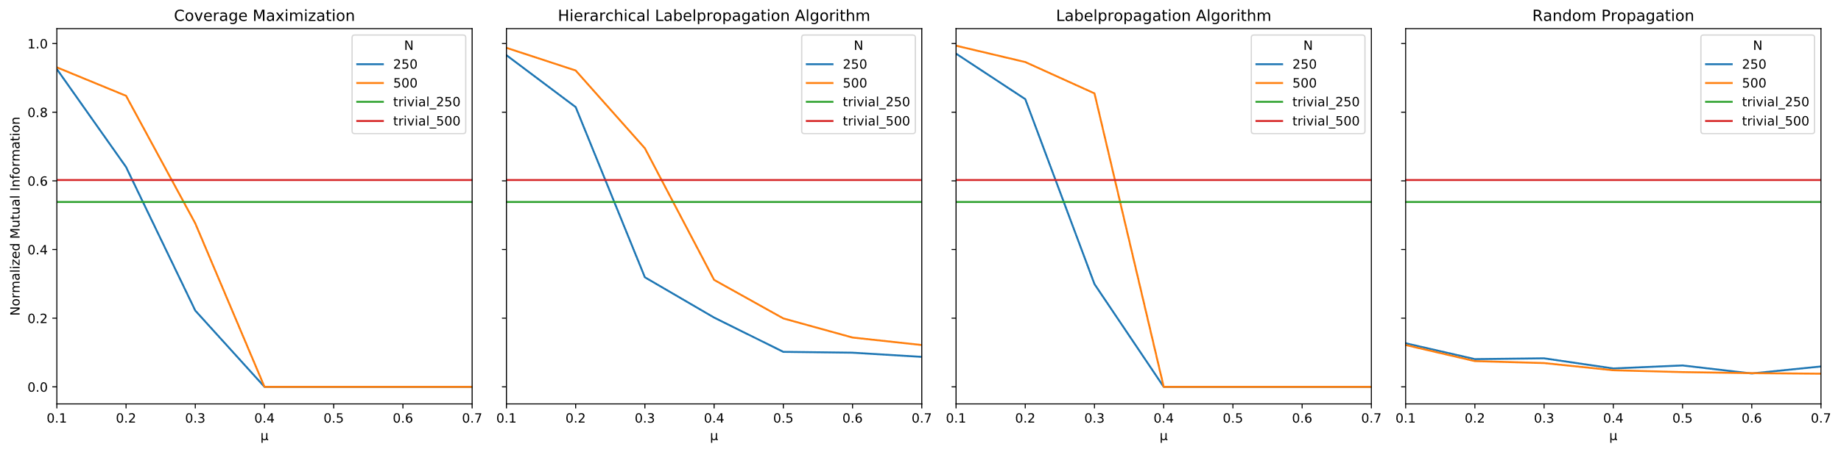
Results - Baselines
Notes:
So here you can clearly see how the baselines do not perform very well. In the case of Coverage Maximization and Labelprogation, the models work well for small mü’s but collapse rather quickly.
It is interesting to see that the hierarchical variant of label propagation does not collapse to a single community. The reason for this might lies mainly in the fact that it stops to optimize early and propagates the the problem to the next iteration. Turning the global optimization step into a more local and fine-grained step.
The random propagation performance show, that the hierarchical structure of Louvain core does not improve the performance by its own. An informed decision is required.

Slide 14
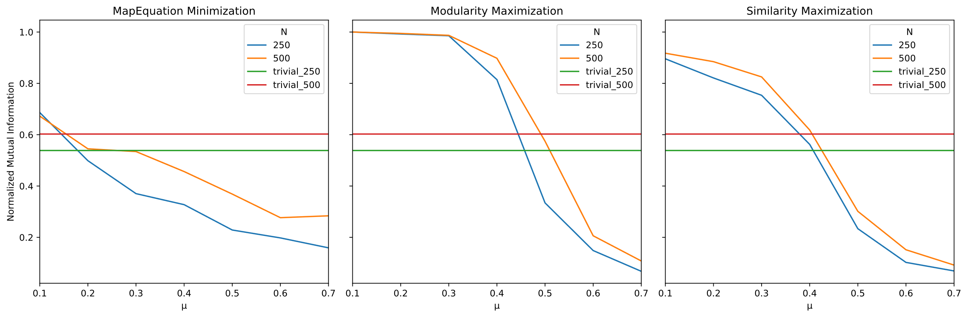
Results - Models
Notes:
These results are a bit more interesting. Louvain returns the best result. Reproducing the results of Lancichinetti. However, the MapEquation based algorithm does not perform as well as InfoMap. Indicating that InfoMap does more than just employing the Louvain-Core heuristic. A paper by Bohlin et. al. supports this claim.

Slide 15
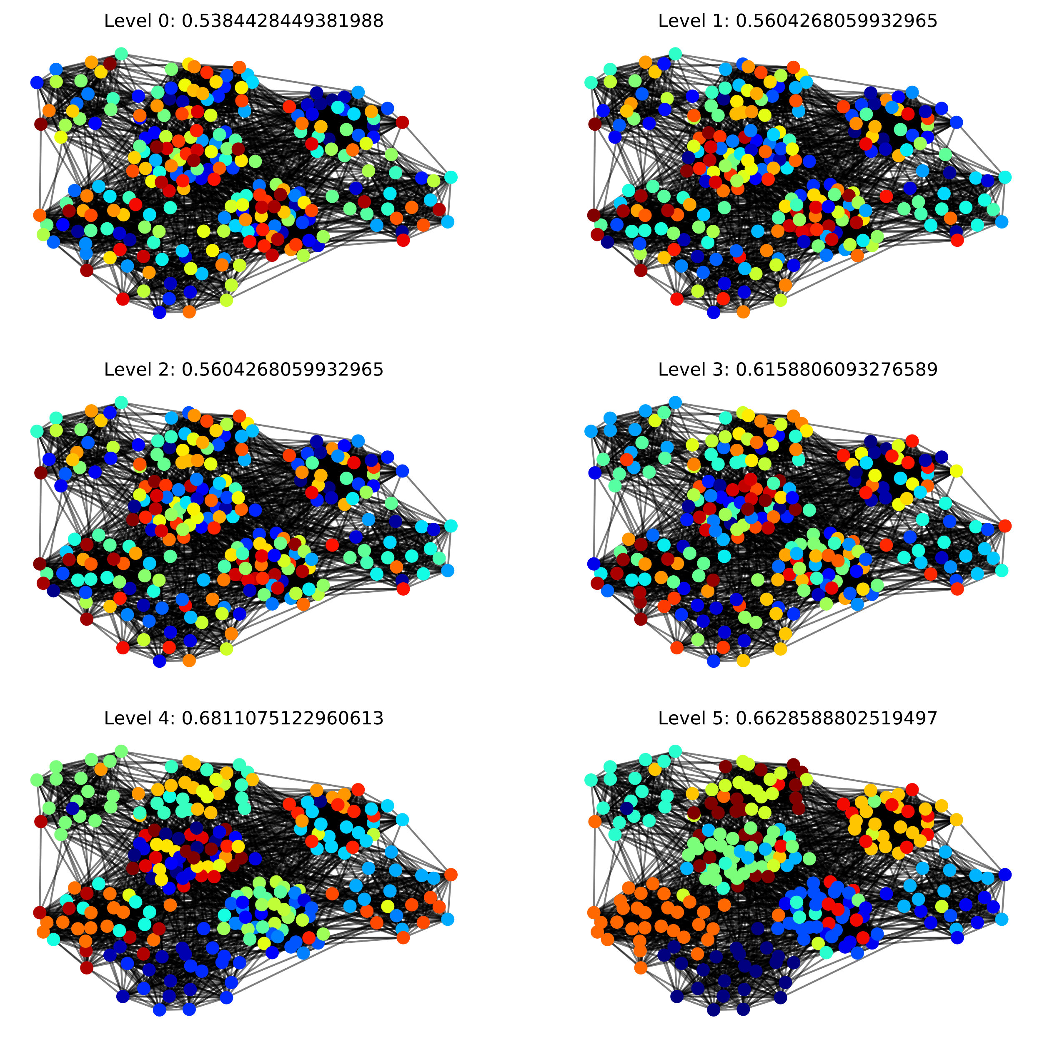
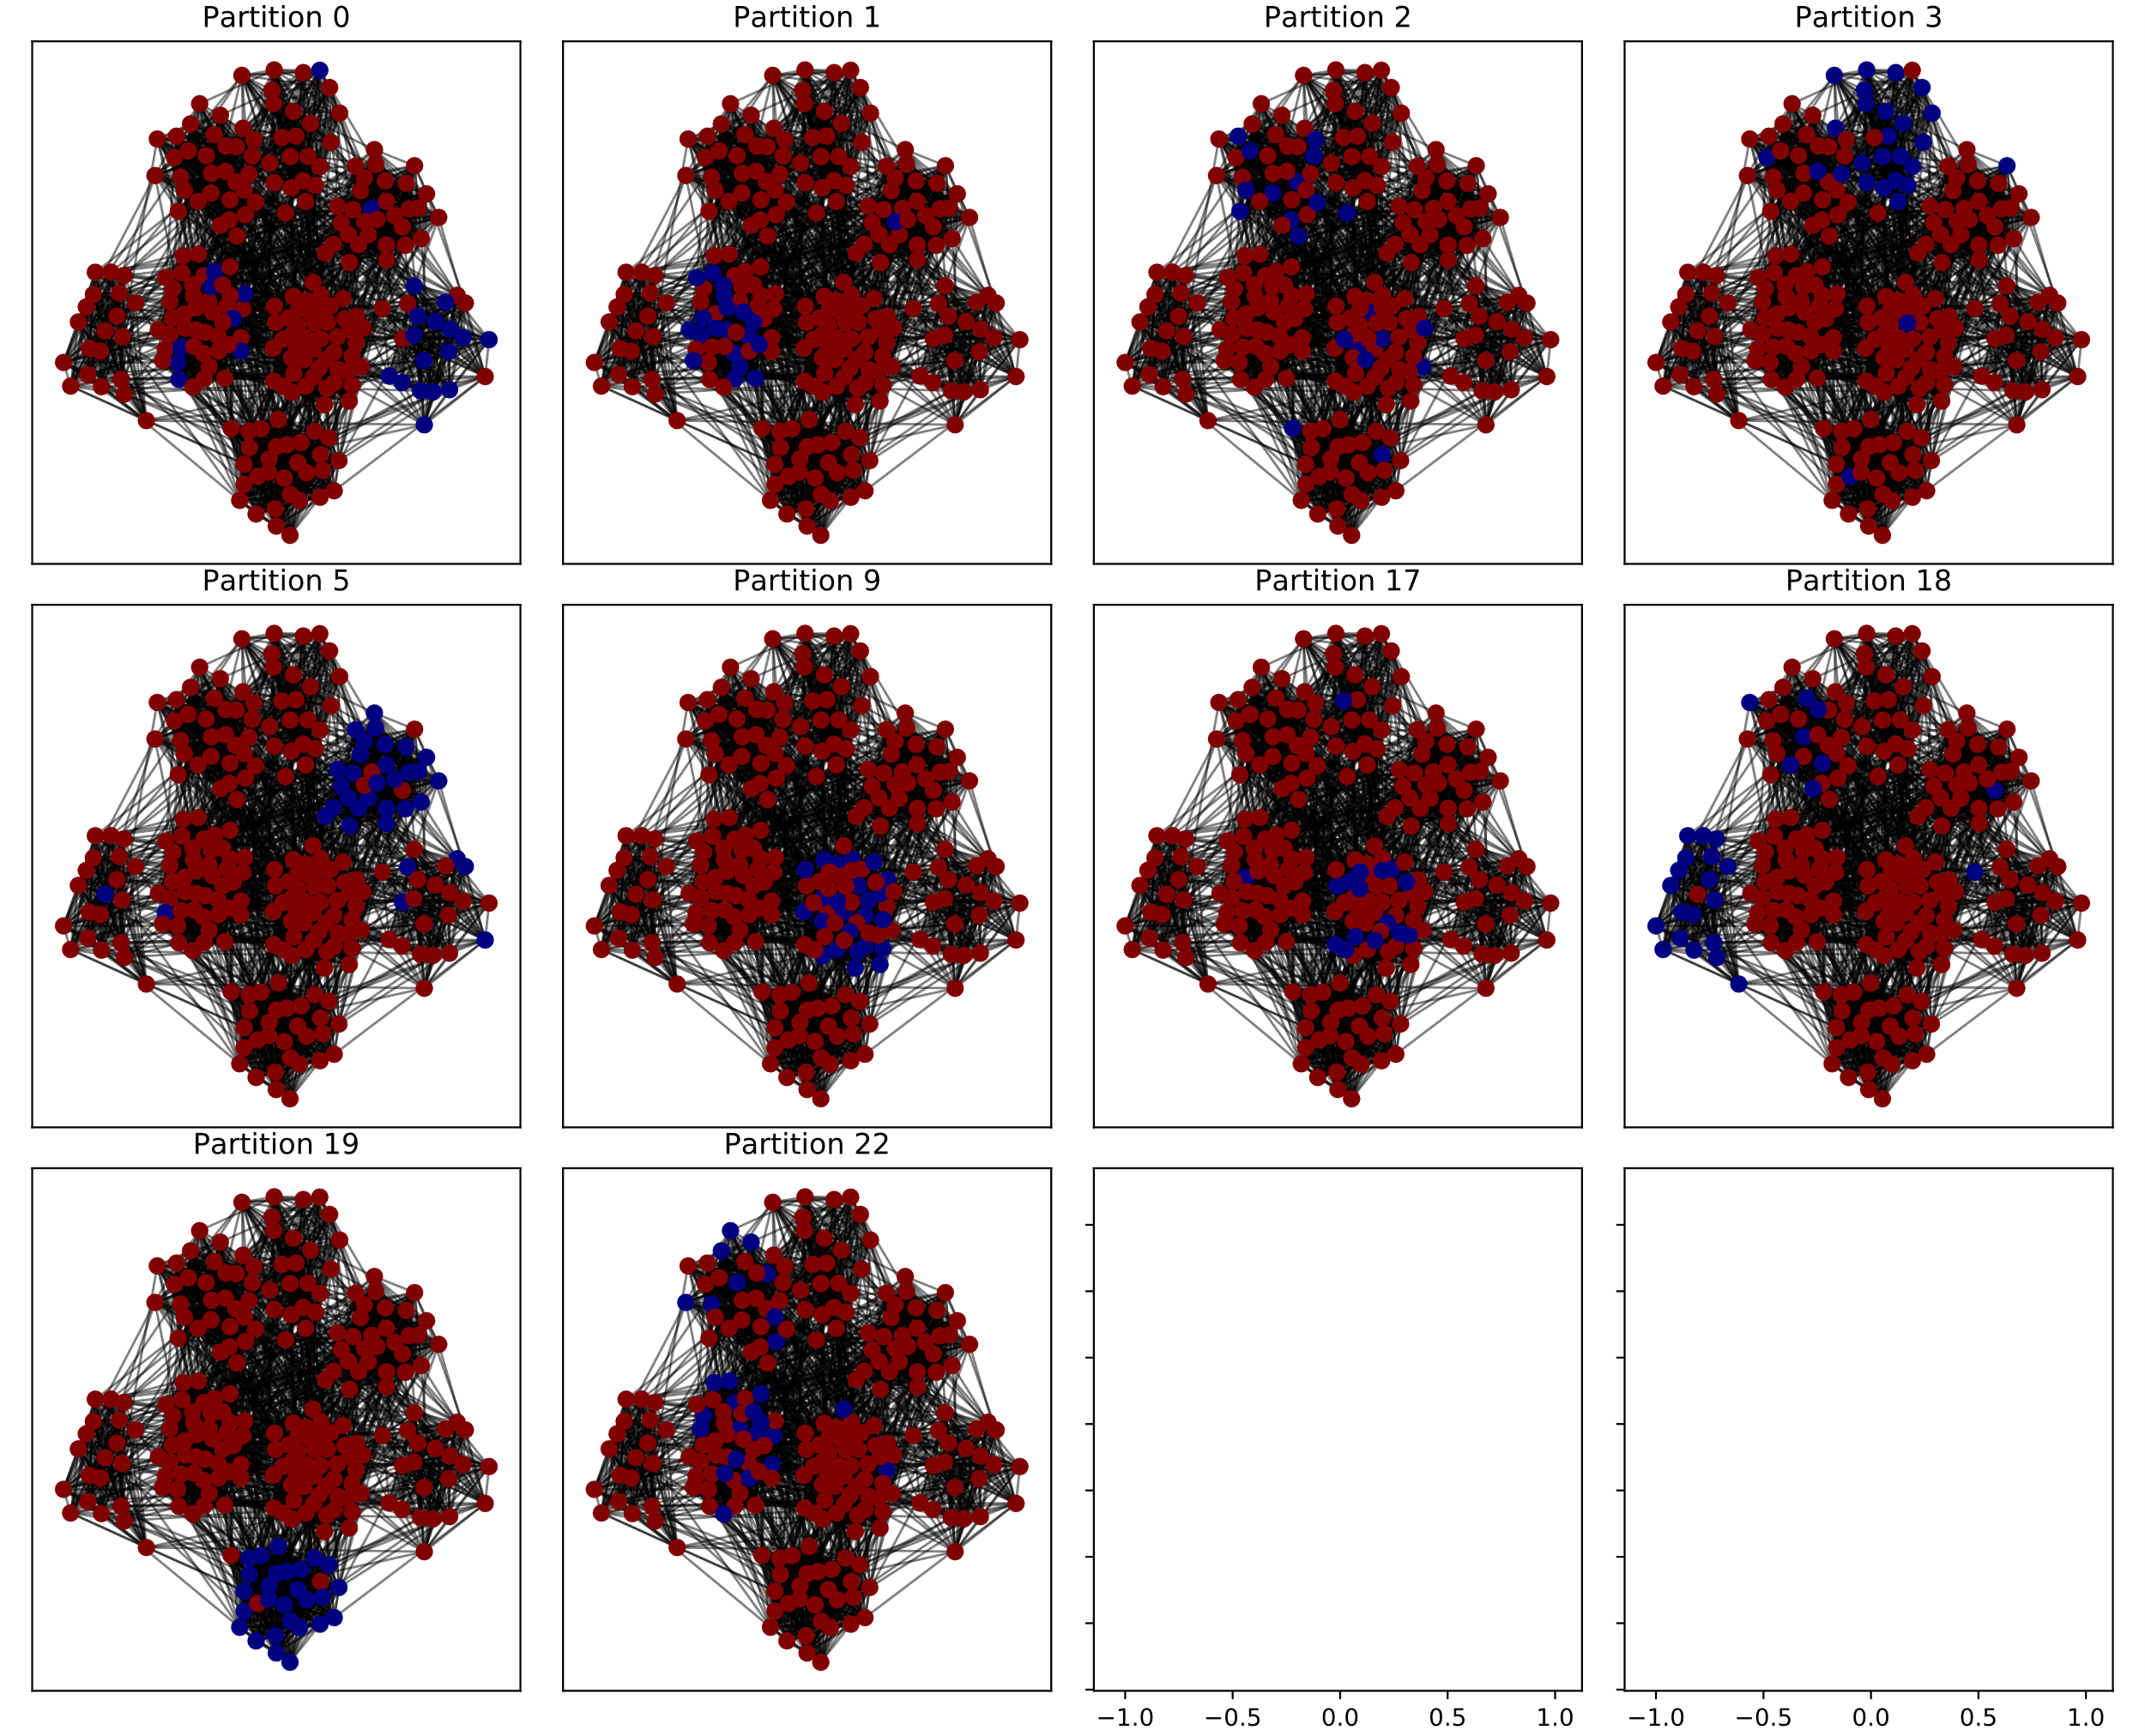
Results –MapEquation in Depth
Notes:
So why is that the case? Mainly because Louvain Core is a bit to strong for the MapEquation model. If communities are merged wrongly there is no way of reseparating them. MapEquation does not account for that.
This hints at the role of the algorithm for the model. It seems like the main purpose of the algorithm is to mitigate shortcomings of the model. Interestingly, we can see the same behaviour in modularitation. It is known to suffer from resolution issues. However, the hierarchical nature of Louvain seems to account for that.

Slide 16
Results - Models
Notes:
In the case of similarity maximization we can clearly see that it works reasonably, albeit not outperforming Louvain. This is surprising as the literature has not yet rediscovered node-similarity as a viable model. However, several decisions were made, that can be questioned and require further research. For instance, how to produce node embeddings in subsequent itererations. I chose to just average the embeddings. But I could have also retrained them or chose the median node. Same goes for the decision to use L2 as a distance function. Cosine similarity or Manhattan distance might’ve been viable options, too.

Slide 17
Summary
What is the influence of the model on the NMI performance of the community detection task?
Without a model the heuristic will perform poorly for increasingly complex community structures.
The model alone does not govern the result. Its shortcoming has to be mitigated by the algorithm.
Many models are viable and node similarity seems a promising alternative
Which model yields the best performance?
The Louvain algorithm performed best
Second best was the node similarity approach
MapEquation & Labelpropagation do not perform well without further interference
Notes:
Coming back to the questions I posed at the beginning. What is the influence of the model on the performance?

